Slide 1
Practical Exercise 1
Classes, objects, getters, setters, polymorphism

Slide 2
Introduction
In this exercise, you will create a series of classes and work with various OOP concepts in Python.
This includes concepts such as classes, objects, the @property and @classmethod keywords, polymorphism and access modifiers.
Follow the tasks outlined in the following slides and write the code as necessary to complete each task.
For my lazy students, the code for this exercise is at https://github.com/Nguh-Prince/Introduction-to-Flask-and-Django/blob/main/practical_exercises/practical_exercise_1.py

Slide 3
Task 1: Base class with a property, a getter and setter
Create a base class Person.
Define the class with the following members:
An __init__ method that accepts name and age as parameters and initializes corresponding private instance attributes.
An __str__ method that returns a string representation of the Person instance (i.e. <name>: <age> years)
Define a property called age using the @property decorator. The property should return the age attribute (getter).
Define a setter for the age property using the @age.setter decorator. The setter should allow you to set the age attribute ensuring that the age is a positive integer.

Slide 4
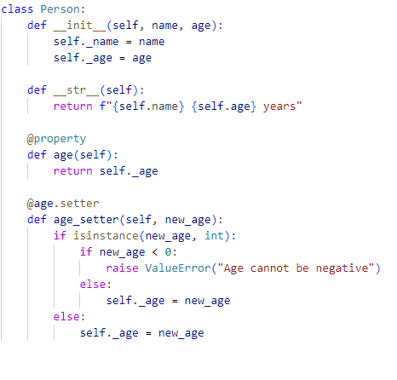

Slide 5
Task 1: Base class with a property, a getter and setter
Write a getter and setter for the name attribute
The setter should validate that the name passed is a string and has at least 2 names (i.e. a first and a last name)
You can add more validations if you see fit.

Slide 6
Task 2: Define a subclass that overrides a method
Create a subclass called Employee that inherits from the Person class
Add an employee_id to the __init__ method of the Employee class.
Override the __str__ method in the Employee class to include the employee_id in the string representation (i.e. <id>: <name>: <age> years)
Add a getter and setter for the employee_id attribute. The setter needs to validate that the value is an integer

Slide 7
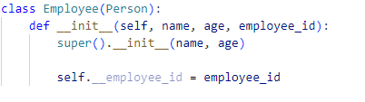

Slide 8
Task 3: Use a class method to create a new instance
In the Employee class, define a class method called `from_string` that takes a string of the form “name,age,employee_id” and returns a new Employee instance.
Split the input string by commas and pass the resulting values as arguments to create a new instance of Employee.

Slide 9
Task 4: Implement polymorphism
Create another subclass Customer that inherits from the Person class.
Add a customer_id to the __init__ method of the Customer class
Override the __str__ method in the Customer class to include the customer_id in the string representation of the instance

Slide 10
Task 5: Demonstrate polymorphism
Define a function called print_info that accepts an instance of Person as a parameter and prints the string representation of the instance
Create an instance of Employee and an instance of Customer
Pass the instances to the print_info function and observe the different string representations due to polymorphism

Slide 11
Task 6: Demonstrate polymorphism
In the Person class, add a protected attribute called _email and a private attribute called __password
Define a getter and setter for email and password.
In the setter for the email, include a basic validation to check if the email is in the correct format.
In the setter for __password, include a validation for the length (>= 8 characters)
Create an instance of Person and try accessing the protected and private attributes directly. Observe the behavior and adjust the code to access them using the methods provided

